Slide 1
Regression Analysis
Dr. Basharat Mahmood
Department of Computer Science
COMSATS University Islamabad

Slide 2
REGRESSION ANALYSIS
Regression analysis is used to:
Predict the value of a dependent variable based on the value of at least one independent variable
Explain the impact of changes in an independent variable on the dependent variable
Provides an equation to be used for estimating the value of dependent variable against some known value of independent variable
Dependent variable: the variable we wish to predict or explain
Independent variable: the variable used to predict or explain the dependent variable

Slide 3
UTILITY OF REGRESSION
Degree & Nature of relationship
Forecasting
Making data-driven decisions
Recognizing opportunities to improve

Slide 4
DIFFERENCE BETWEEN CORRELATION &
REGRESSION
Degree & Nature of Relationship
Correlation is a measure of degree of relationship between X & Y
Regression studies the nature of relationship between the variables so that one may be able to predict the value of one variable on the basis of another.
Cause & Effect Relationship
Correlation does not always assume cause and effect relationship between two variables.
Regression clearly expresses the cause and effect relationship between two variables. The independent variable is the cause and dependent variable is effect.

Slide 5
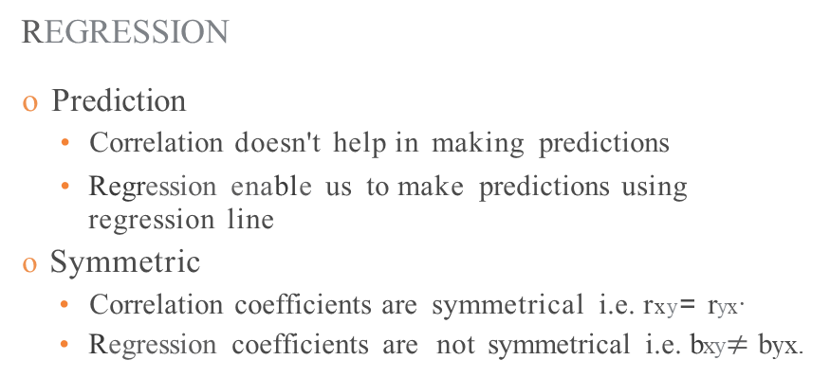
DIFFERENCE BETWEEN CORRELATION &
REGRESSION
Prediction
Correlation doesn't help in making predictions
Regression enable us to make predictions using regression line
Symmetric
Correlation coefficients are symmetrical i.e. rxy= ryx·
Regression coefficients are not symmetrical i.e. bxy$≠$ byx.

Slide 6
TYPES OF REGRESSION ANALYSIS
Simple & Multiple Regression
Linear & Non-Linear Regression
Partial & Total Regression
Logistic Regression

Slide 7

SIMPLE LINEAR REGRESSION
Simple Linear Regression
Regression Lines
Regression Equations
Regression Coefficients

Slide 8
REGRESSION LINES
The regression line shows the average relationship between two variables. It is also called Line of Best Fit.
If two variables X & Y are given, then there are two regression lines:
Regression Line of X on Y
Regression Line of Y on X
Nature of Regression Lines
If r = ±1, then the two regression lines are coincident.
If r = 0, then the two regression lines intersect each other at 90°.
The nearer the regression Lines are to each other, the greater will be the degree of correlation.
If regression lines rise from left to right upward, then correlation is positive.

Slide 9
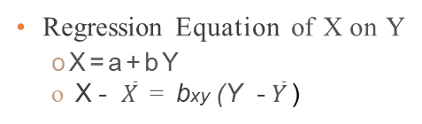
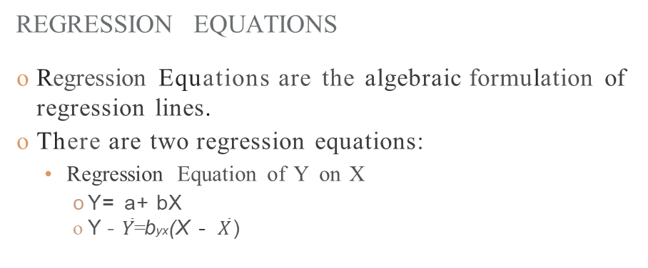
REGRESSION EQUATIONS
Regression Equations are the algebraic formulation of regression lines.
There are two regression equations:
Regression Equation of Y on X
Y= a+ bX
Y - $\overline{Y}$= byx(X - $\overline{X}$ )
Regression Equation of X on Y
oX=a+bY
o X - $\overline{X}$ = bxy (Y - $\overline{Y}$ )

Slide 10
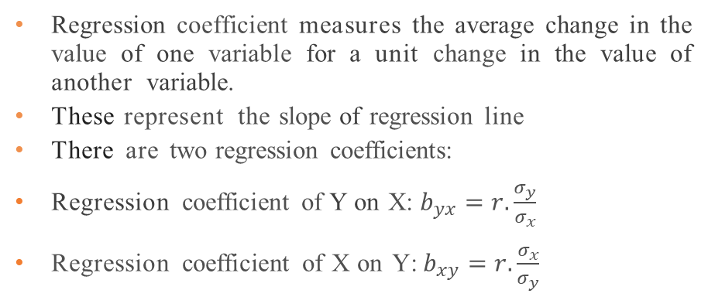
REGRESSION COEFFICIENTS
Regression coefficient measures the average change in the value of one variable for a unit change in the value of another variable.
These represent the slope of regression line
There are two regression coefficients:
Regression coefficient of Y on X: $b_{yx}=r.\frac{σ_{y}}{σ_{x}}$
Regression coefficient of X on Y: $b_{xy}=r.\frac{σ_{x}}{σ_{y}}$

Slide 11
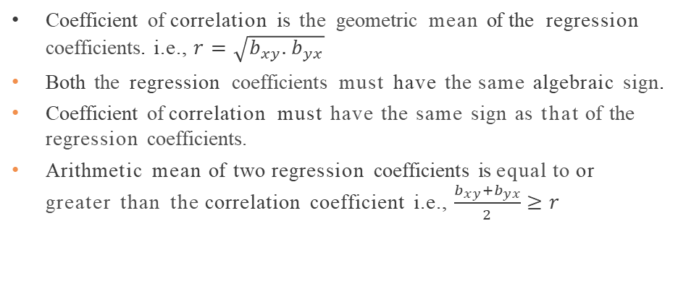
PROPERTIES OF REGRESSION COEFFICIENTS
Coefficient of correlation is the geometric mean of the regression coefficients. i.e., $r=\sqrt{b_{xy}.b_{yx}}$
Both the regression coefficients must have the same algebraic sign.
Coefficient of correlation must have the same sign as that of the regression coefficients.
Arithmetic mean of two regression coefficients is equal to or greater than the correlation coefficient i.e., $\frac{b_{xy}+b_{yx}}{2}≥r$

Slide 12
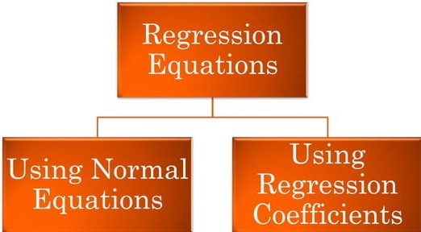
OBTAINING REGRESSION EQUATIONS

Slide 13
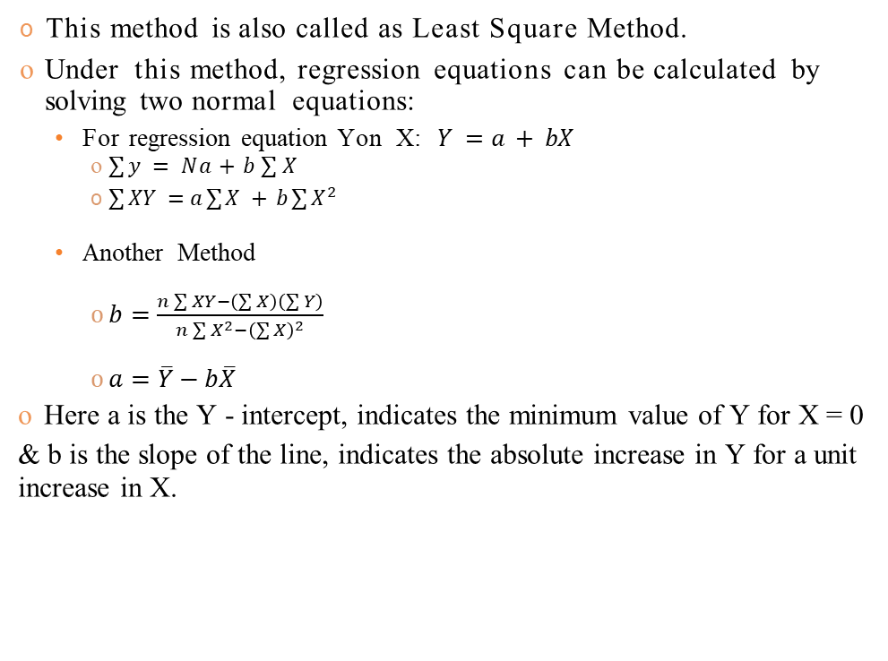
REGRESSION EQUATIONS USING NORMAL EQUATIONS
This method is also called as Least Square Method.
Under this method, regression equations can be calculated by solving two normal equations:
For regression equation Yon X: $Y =a + bX$
$\sum{y} = Na+b\sum{X}$
$\sum{XY} = a\sum{X} + b\sum{X^{2}}$
Another Method
$b=\frac{n\sum{XY−\left(\sum{X}\right)\left(\sum{Y}\right)}}{n\sum{X^{2}−{\left(\sum{X}\right)}^{2}}}$
$a=\overline{Y}−b\overline{X}$
Here a is the Y - intercept, indicates the minimum value of Y for X = 0
& b is the slope of the line, indicates the absolute increase in Y for a unit increase in X.

Slide 14
Residual
The difference between the observed value y_{i} and the corresponding fitted value .
Residuals are highly useful for studying whether a given regression model is appropriate for the data at hand.

Slide 15
Estimation of the variance of the error terms, σ²
The variance σ² of the error terms ε_{i} in the regression model needs to be estimated for a variety of purposes.
It gives an indication of the variability of the probability distributions of y.
It is needed for making inference concerning regression function and the prediction of y.
To estimate σ we work with the variance and take the square root to obtain the standard deviation.
For simple linear regression, the estimate of σ² is the average squared residual.

Slide 16


REGRESSION EQUATIONS USING REGRESSION COEFFICIENTS (USING ACTUAL VALUES)
o Regression Equation of Yon X
o Regression Equation of X on Y

Slide 17
PRACTICE PROBLEMS
Ql: Calculate the regression equation of X on Y using method of least squares:
Also find the variance of the error terms.
X | 5 | 7 | 9 | 8 | 11 | 12
Y | 14 | 18 | 25 | 29 | 32 | 37

Slide 18
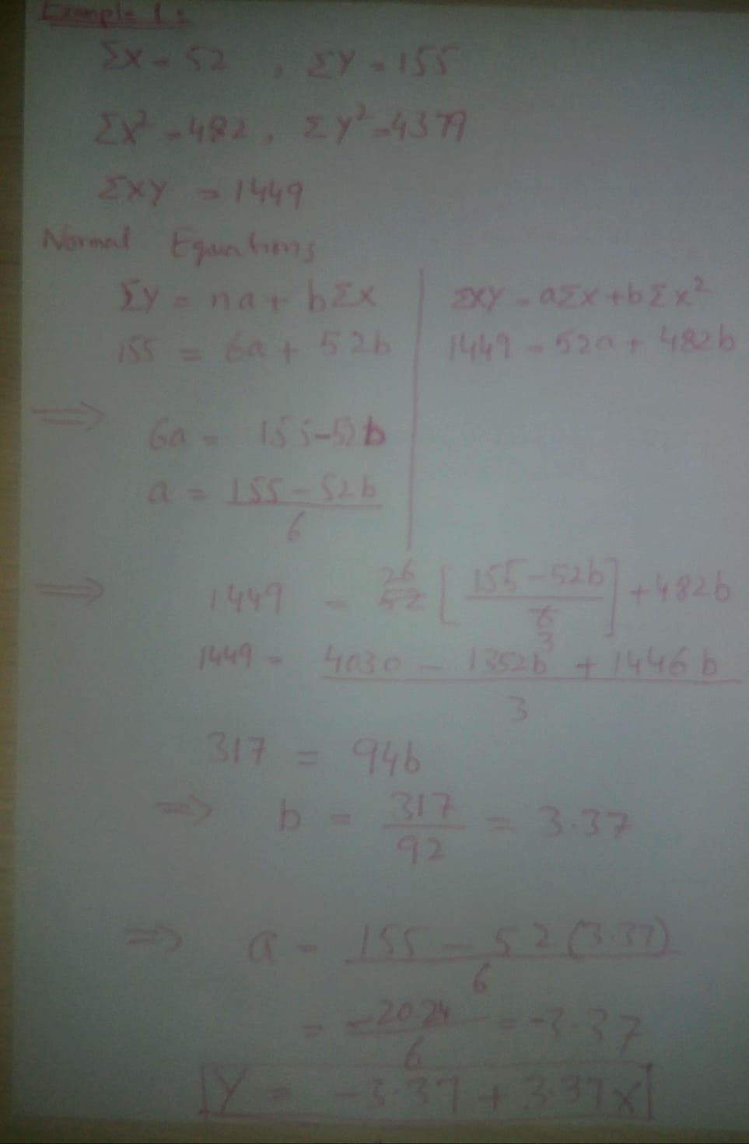
PRACTICE PROBLEMS

Slide 19
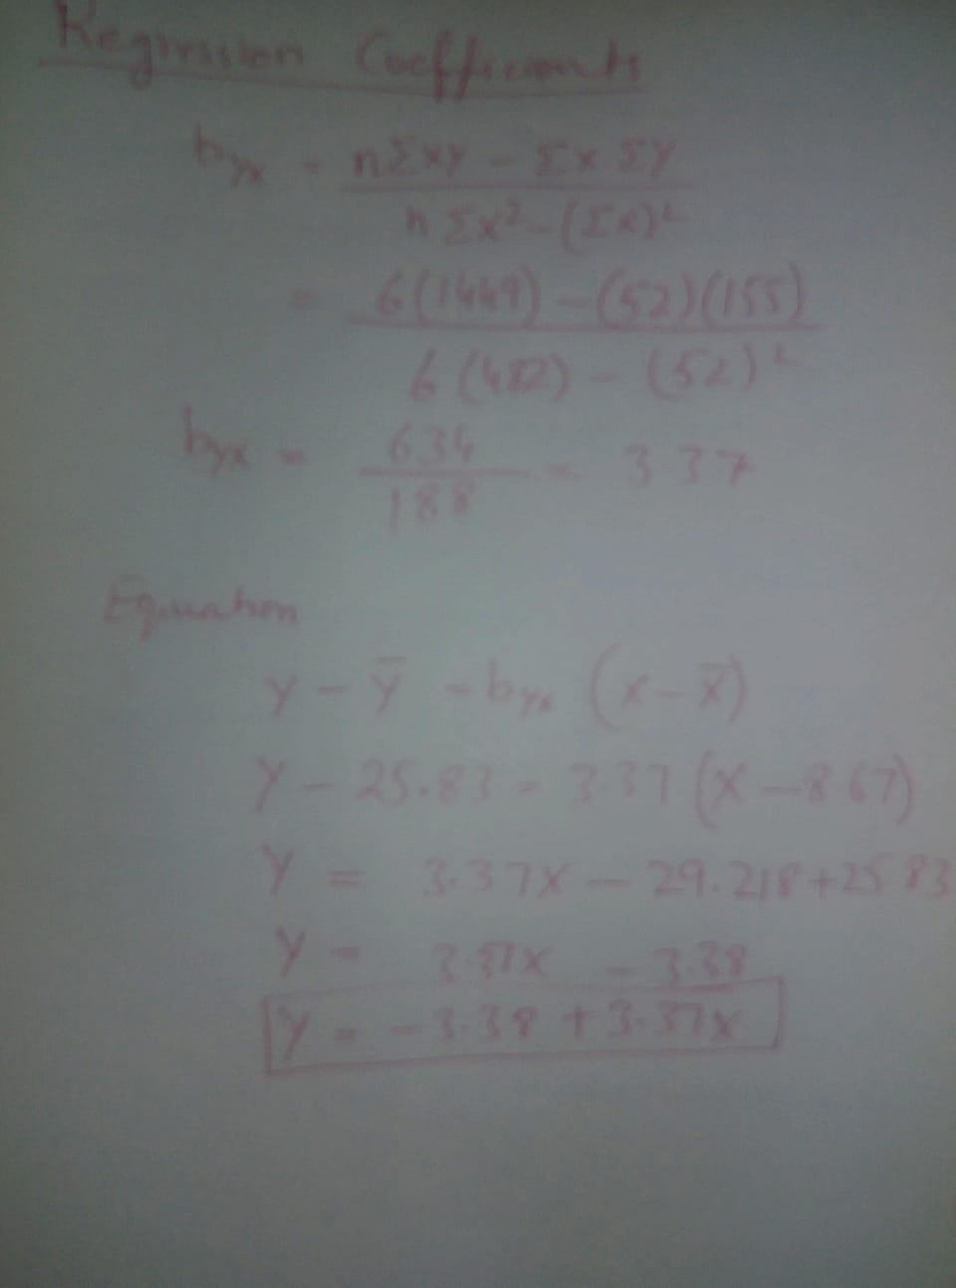
PRACTICE PROBLEMS

Slide 20
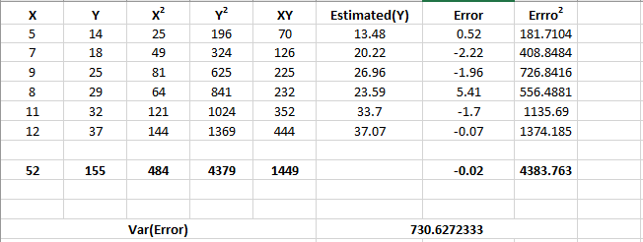
PRACTICE PROBLEMS

Slide 21
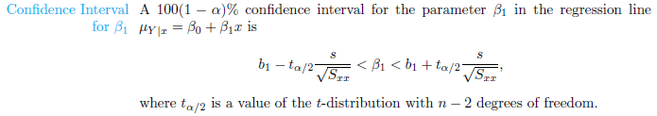




INFERENCE CONCERNING THE REGRESSION COEFFICIENTS
Where

Slide 22
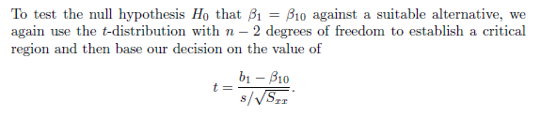
TESTING ABOUT REGRESSION COEFFICIENT

Slide 23
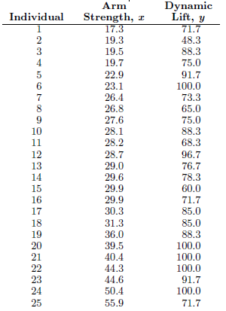
TESTING ABOUT REGRESSION COEFFICIENT
Example: A study was conducted at Virginia Tech to determine
if certain static arm-strength measures have an influence on the “dynamic lift” characteristics of an individual. Twenty-five individuals were subjected to strength tests and then were asked to perform a weightlifting test in which weight was dynamically lifted overhead.
The data are given here.

Slide 24
TESTING ABOUT REGRESSION COEFFICIENT
Fit a linear regression line for the given data
Compute the residuals and verify that they add to zero
Find a 95% confidence interval for b in the regression
Test the hypothesis that b = 1.0 against the alternative that b < 1.0.

Slide 25
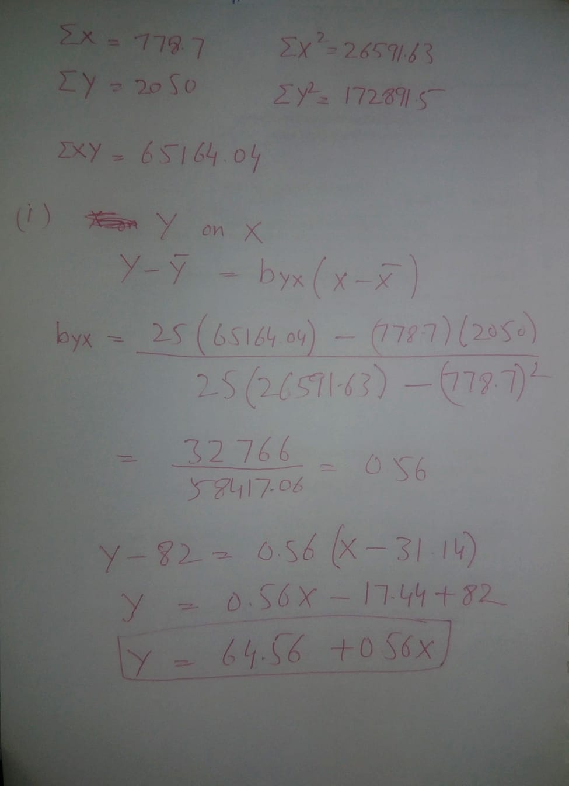

Slide 26
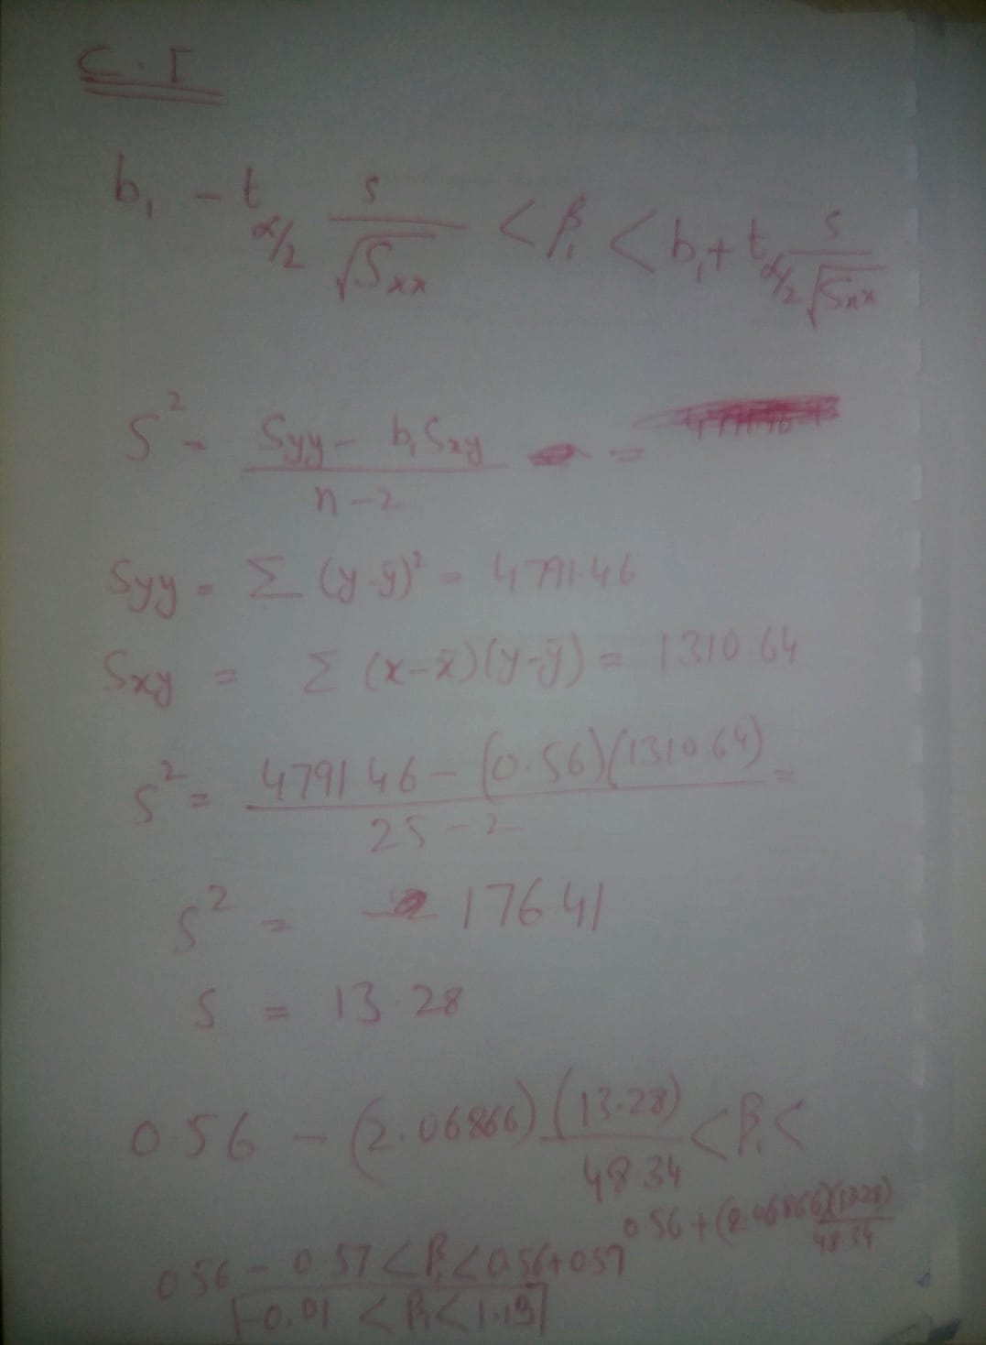

Slide 27
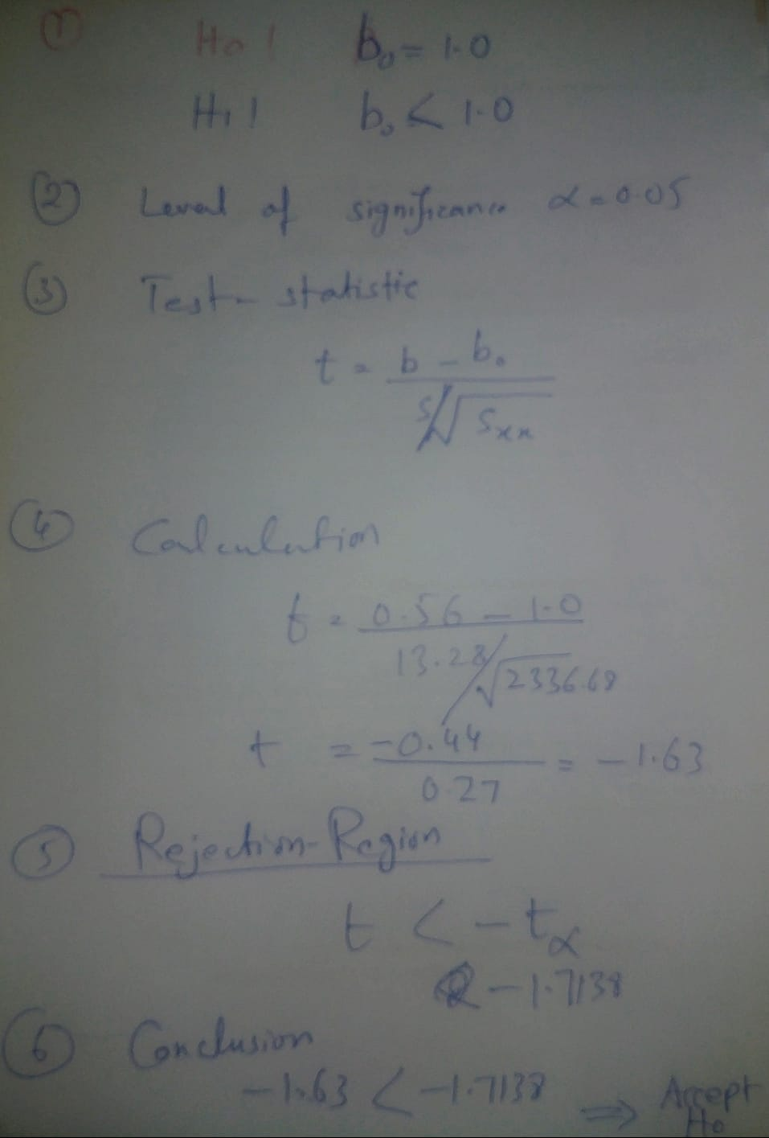

Slide 28
Multiple Regression Analysis (MRA)
Method for studying the relationship between a dependent variable and two or more independent variables.
Y’ = a + b₁X₁ + b₂X₂ + …b_{k}X_{k}
Purposes:
Prediction
Explanation
Theory building

Slide 29
Multiple Regression Analysis (MRA)
The following are situations where we can use multiple regression:
Testing if IQ and level of education affect income (IQ and years of education are the IV and income is the DV).
Testing if study time and pre-test scores affect final grades (DV is final grades, and study time and pre-test scores are the IV).
Testing if exercise and amount of salt in the diet affect blood pressure (exercise and salt are the IV and blood pressure is the DV).

Slide 30
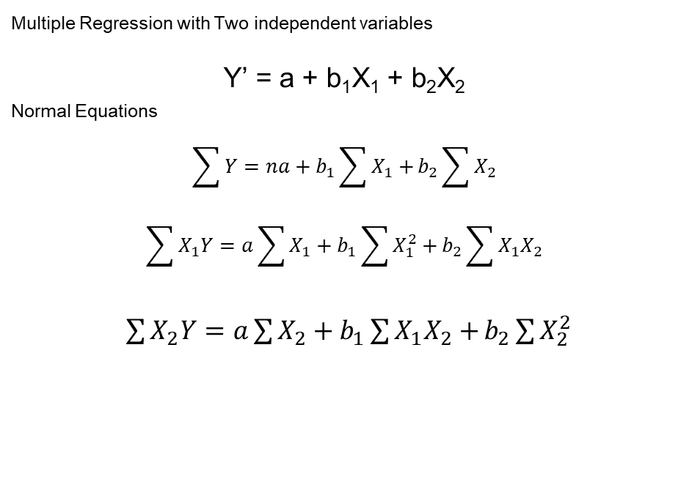
Multiple Regression Analysis (MRA)
Multiple Regression with Two independent variables
Y’ = a + b₁X₁ + b₂X₂
_{Normal Equations}
$$\sum{Y=na+b_{1}\sum{X_{1}}+}b_{2}\sum{X_{2}}$$
$$\sum{X_{1}Y=a\sum{X_{1}}+b_{1}\sum{X_{1}^{2}}+}b_{2}\sum{X_{1}X_{2}}$$
$\sum{X_{2}Y=a\sum{X_{2}}+b_{1}\sum{X_{1}X_{2}}+}b_{2}\sum{X_{2}^{2}}$

Slide 31
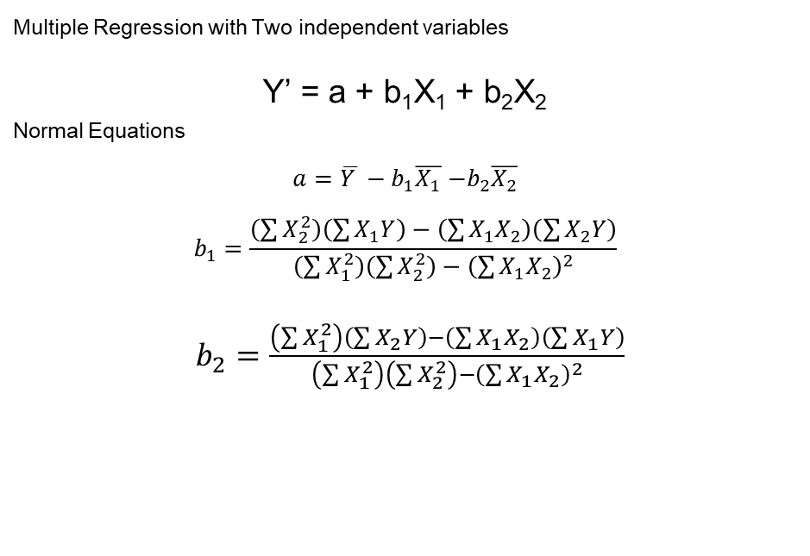
Multiple Regression Analysis (MRA)
Multiple Regression with Two independent variables
Y’ = a + b₁X₁ + b₂X₂
_{Normal Equations}
$a=\overline{Y }−b_{1}\overline{X_{1}}$ $−b_{2}\overline{X_{2}}$
$$b_{1}=\frac{\left(\sum{X_{2}^{2}}\right)\left(\sum{X_{1}Y}\right)−\left(\sum{X_{1}X_{2}}\right)\left(\sum{X_{2}Y}\right)}{\left(\sum{X_{1}^{2}}\right)\left(\sum{X_{2}^{2}}\right)−{\left(\sum{X_{1}X_{2}}\right)}^{2}}$$
$b_{2}=\frac{\left(\sum{X_{1}^{2}}\right)\left(\sum{X_{2}Y}\right)−\left(\sum{X_{1}X_{2}}\right)\left(\sum{X_{1}Y}\right)}{\left(\sum{X_{1}^{2}}\right)\left(\sum{X_{2}^{2}}\right)−{\left(\sum{X_{1}X_{2}}\right)}^{2}}$

Slide 32

Multiple Regression Analysis (MRA)
_{Coefficient of Determination}
$$R^{2}=\frac{b_{1}\sum{X_{1}Y −}b_{2}\sum{X_{2}Y }}{\sum{Y^{2}}}$$
or
$$R^{2}=1−\frac{\sum{{\left(Y−\hat{Y}\right)}^{2}}}{\sum{{\left(Y−\overline{Y}\right)}^{2}}}$$

Slide 33
Polynomial Regression
Polynomial regression, describes the fitting of a nonlinear relationship between the value of x and y.
Examples:
Number of click on a post
total working hours per week vs. overall happiness

Slide 34
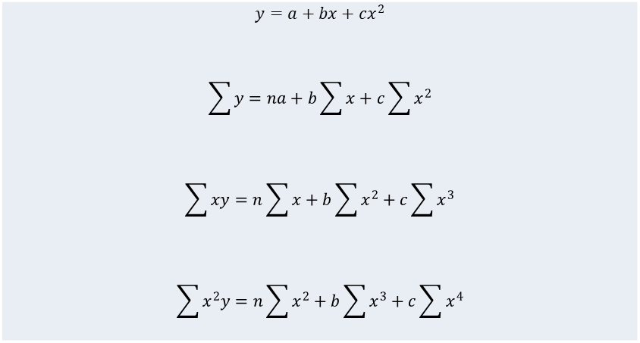
Polynomial Regression
Quadratic regression calculation
$$y=a+bx+cx^{2}$$ $$\sum{y}=na+b\sum{x}+c\sum{x^{2}}$$ $$\sum{xy}=n\sum{x}+b\sum{x^{2}}+c\sum{x^{3}}$$ $$\sum{x^{2}y}=n\sum{x^{2}}+b\sum{x^{3}}+c\sum{x^{4}}$$

